Slide 1
Serverless Data Analytics
李涛
2021.12.24
Notes:
- 传统的serverless应用
-- 有网络微服务，比如社交网络；和物联网应用，比如网上商店。
-- 特征：这类应用比较简单，大部分请求只会调用一个函数
- serverless 数据分析应用
-- 比如说mapreduce模式的大规模排序、视频分析（编码、图像识别）、数据库查询处理
-- 特征：每个请求包含多个阶段，不同阶段的任务需要分享状态和数据

Slide 2
Background
Traditional serverless application
eg：web microservices and IoT applications
Characteristics：per request consists of a single function
Serverless data analytics
eg：MapReduce Sort、Video analytics、Query processing...
Characteristics
per request consist of multiple stages
require sharing of state and data across stages of tasks

Slide 3
Motivation
Serverless
High elasticity
Fine-grain billing
Short startup time
Data analytics
Low resource utilization
Within a stage：BSP
Across stages：TPC-DS query 95：0.8Mb ~ 66Gb
Interactive requirement
Interactive queries
High resource utilization & Low cost & Low latency
Notes:
- serverless
-- 高弹性，伸缩扩展能力强
-- 细粒度的收费：按需收费，根据存储计算资源的使用情况进行收费，同时以毫秒为力度进行收费，传统架构按照小时或者分钟收费
-- 启动时间短，通常使用容器作为函数实例化的沙箱，相较于虚拟机来说，启动时间短
- data analytics
-- 资源利用率低
-- 有些任务有时延上的要求，比如说交互式的查询任务

Slide 4
Challenges
Serverless function communication
Local storage
no long-running application framework
agent to manage local storage
limited local storage
Direct communication
no control over task scheduling or placement
execute time limitation
Remote slow storage
S3(object storage)
DynamoDB(KV database)
AWS lambdas 3GB RAM 512MB disk
Notes:
- serverless函数通信主要有两种方案：本地存储或者直接通信
-- 本地存储，比如Spark Hadoop都是通过这种方式传输中间数据
--- 一方面没有持久运行的客户端管理这些本地的存储资源
--- 每个函数分配的存储资源十分有限
-- 直接通信
--- 无法控制任务的调度和放置，无法保证接收方和发送方同步执行
--- 执行时间有限，数据传输可能无法全部完成

Slide 5
Challenges
Data analytics characteristics
Large scale shuffle
Serverless function communication
Remote slow storage
High latency

Slide 6
Serverless Computing
存储计算分离
Serverless = FaaS + BaaS ^{[1]}
Serverless
sandbox
API Gateway
object storage
request
stateless
function
data、state....
KV database
.....
FaaS
BaaS
Serverless computing model
[1] Cloud Programming Simplified: A Berkeley View on Serverless Computing
Notes:
- serverless 采用的是存储计算分离的方式，由FaaS提供计算资源，BaaS提供存储服务
- 下面是一个serverless的计算模型：当请求到达时，首先通过API网关路由到对应的沙箱，然后在沙箱中实例化无状态函数进行计算，函数所产生的的状态或者销毁，或 者存储到后端的数据库中

Slide 7
Serverless Computing
FaaS
Data analytics intermediate data
BaaS

Slide 8
FaaS
No long-running application framework agent to manage local storage
Limited local storage

Slide 9

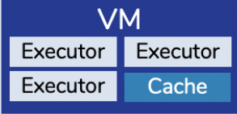
FaaS
Cloudburst^{[2]}
Distributed cache
Cache inconsistencies
Cloudburst Runtime
AutoScaling Key-Vaule Store
An overview of the Cloudburst architecture
[2] Cloudburst: Stateful Functions-as-a-Service VLDB’20
Notes:
- 利用分布式缓存来提供一定的数据局部性，以此来降低通信的时延
- 但是分布式缓存会带来缓存一致性的问题

Slide 10
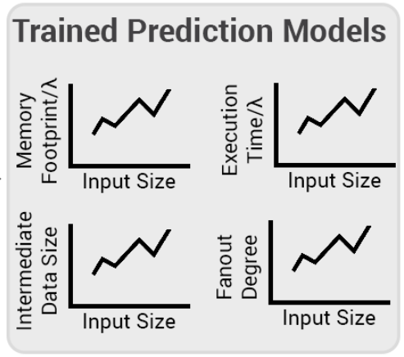
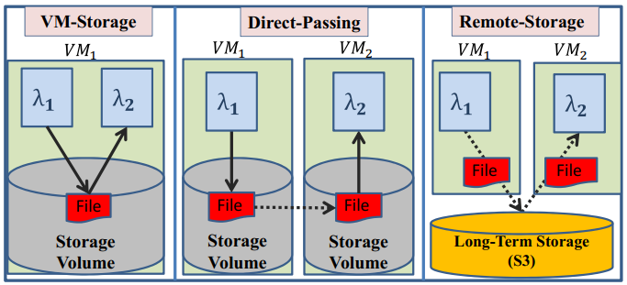

FaaS
SONIC^{[3]}
Hybrid data passing method
best data passing method
Workflow of SONIC
[3] Sonic: Application-aware Data Passing for Chained Serverless Applications ATC’21
Notes:
- 采用混合的数据传输方式，首先训练出一个数据传输方式的预测模型，当新的请求到达时，根据预测模型选择合适的数据传输方式
- 第一种方式需要将函数调度到同一个虚拟机上，但是这种方式不需要数据复制
- 第二种方式直接传输，不同与之前说的直接通信，他是将数据复制到其他函数的虚拟机上，需要一次复制
- 第三种方式通过远程存储交换中间数据，需要复制两次，读写各一次

Slide 11
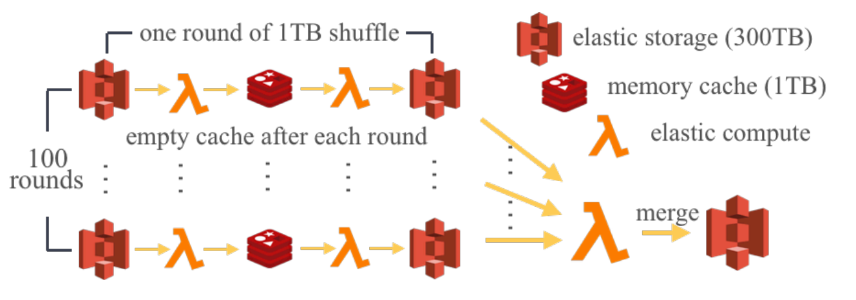
FaaS
Locus^{[4]}
Combines slow storage with fast storage
Illustration for hybrid shuffle
[4] Shuffling, Fast and Slow: Scalable Analytics on Serverless Infrastructure NSDI’19
Notes:
- 将快慢存储进行组合，首先将任务进行分组，每一组内的中间数据由快存储保存，最后将分组的数据合并，以此提高性能

Slide 12
FaaS
Conclusion
solution：involve running additional infrastructure on traditional VMs
challenges：such “serverful” component has the potential to severely
limit the atractiveness of FaaS
Notes:
- 所有解决方案都是在Faas这一端加入一些设备，来缓解FaaS本地存储资源有限的问题
- 这种方案可能会破环serverless的弹性

Slide 13
Serverless Computing
Faas
Data analytics intermediate data
BaaS

Slide 14
Data analytics intermediate data
Intermediate data
Worker
(Function
Invocation)
Worker
(Function
Invocation)
Worker
(Function
Invocation)
read original input
Worker
(Function
Invocation)
Worker
(Function
Invocation)
write intermediate objects
Worker
(Function
Invocation)
Worker
(Function
Invocation)
Worker
(Function
Invocation)
Worker
(Function
Invocation)
Worker
(Function
Invocation)
Worker
(Function
Invocation)
Long-Term Storage (S3)
Worker
(Function
Invocation)
read intermediates
Intermediate Data
wirte final input

Slide 15
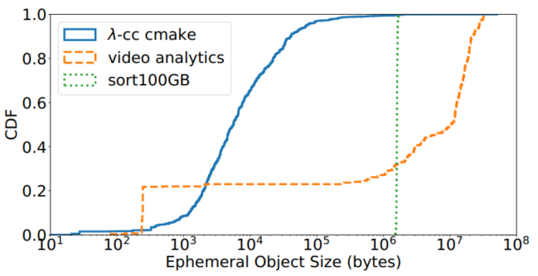
Intermediate data characteristics
Access granularity varies greatly in size
Storage Requirement
High performance for a wide range of object sizes
high bandwidth （large object）
low latency （small object）
high IOPS
Object size distribution
Notes:
- 从对象大小的分布图中看出，不同任务和同一任务内的中间数据的大小分布范围很广
- 因此对后端的存储有一定的要求

Slide 16
Intermediate data characteristics
Burst I/O requests
Scaling up or down storage resource
to meet elastic application demands
adding/removing storage capacity
bandwidth
network bandwidth
CPU cores
Storage Requirement
Automatic and fine-grain scaling
satisfy application I/O requirement
minimizing cost

Slide 17
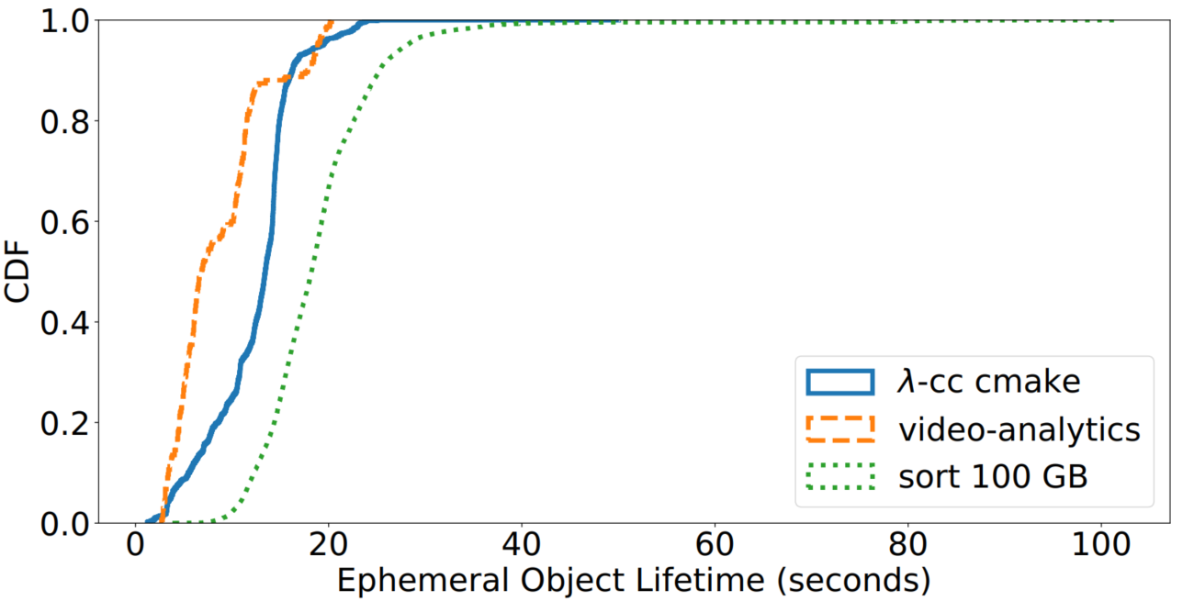
Intermediate data characteristics
Short lifetime
Storage Requirement
Fault-(in)tolerance
only valuable during the execution of a job
easily regenerated
Object lifetime distribution
Notes:
- 从中间数据生命周期的分布可以看出，大部分中间数据的生命周期很短
- it is common for storage systems to use fault-tolerance techniques such as replication and erasure codes

Slide 18
Serverless Computing
Faas
Data analytics intermediate data
BaaS

Slide 19
BaaS
S3
AWS object storage system
Characteristics
Automatic scaling and Fine-grain billing
services automatically scale resources based on usage
charging users only for the capacity($0.23/GB*month) and bandwidth ($0.0004/K*requests)they use
High throughput but High latency
Notes:
High throughput
High latency
the cloud storage system Amazon S3 for large amounts of data
charging users only for the capacity and bandwidth they use
S3 has high latency overhead (e.g., a 1KB read takes ∼12 ms) and insufficient throughput for highly parallel applications

Slide 20
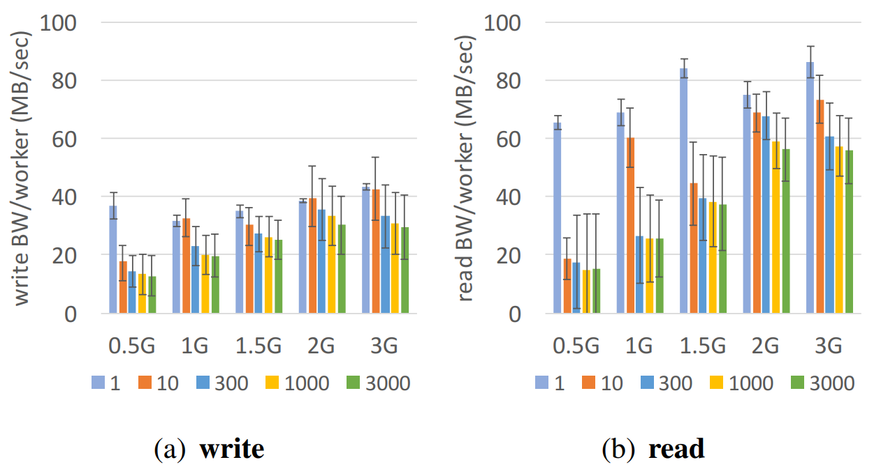
BaaS
S3
Challenge
Bandwith （ Mbytes/sec）
Notes:
- However, these storage systems are not designed to support high throughput on reading and writing small files
- optimized for reading and writing large chunks of data, rather than for high-throughput fine-grained operations

Slide 21
BaaS
S3
Challenge
Throughput（requests/sec, IOPS）
object size | 10KB | 100KB | 1M | 10M | 10M
S3 | 5986 | 4400 | 3210 | 1729 | 1105
aggregate bandwidth | 60MB | 440MB | 3210MB | 17290MB | 11050MB
Notes:
- However, these storage systems are not designed to support high throughput on reading and writing small files
- optimized for reading and writing large chunks of data, rather than for high-throughput fine-grained operations

Slide 22
BaaS
S3
Challenge
degree of parallelism
worker memory size
large amount small objects
bandwith
throughput
Notes:
- However, these storage systems are not designed to support high throughput on reading and writing small files
- optimized for reading and writing large chunks of data, rather than for high-throughput fine-grained operations

Slide 23
BaaS
S3
原因（待调研）

Slide 24
BaaS
Other Storage
Storege System | Elastic scaling | Latency | Throughput | Max object size | Cost
S3 | Auto,coarse-grain | High | Medium | 5 TB | $
DynamoDB | Auto, fine-grain, pay per hour | Medium | Low | 400 KB | $$
Elasticache Redis | Manual | Low | High | 512 MB | $$$
Aerospike | Manual | Low | High | 1 MB | $$
Apache Crail | Manual | Low | High | any size | $$
Desired | Auto,fine-grain, pay per second | Low | High | any size | $

Slide 25
BaaS
DynamoDB
low latency but unacceptably high cost for large shuffles

Slide 26
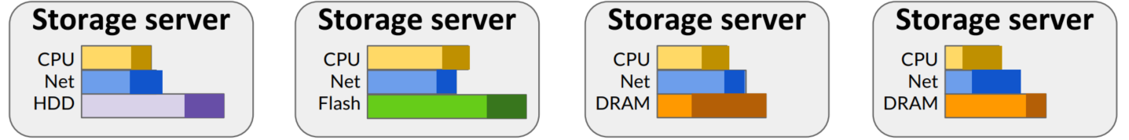
BaaS
Pocket^{[5][6]}
Multi-tier storage
Request
Controller
app-driven resource
allocation & scaling
Pocket system architecture
[5] Pocket: Elastic Ephemeral Storage for Serverless Analytics OSDI’18
[6] Understanding Ephemeral Storage for Serverless Analytics ATC’18

Slide 27
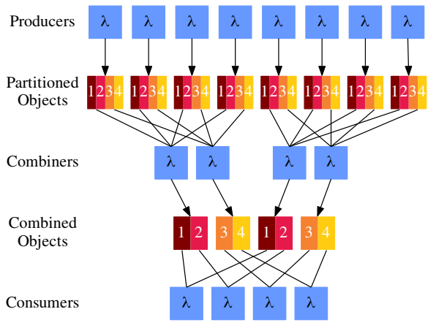
BaaS
shuffle optimized for object storage^{[7][8]}
Performance
High latency：256KB read has median latency of 14ms
Parallelizing reads
Cost
10⁵ mappers and reducer 10¹⁰ intermediate files $5,000
[7] Starling: A Scalable Qery Engine on Cloud Functions SIGMOD’20
[8] Lambada: Interactive Data Analytics on Cold Data Using Serverless Cloud Infrastructure SIGMOD’20

Slide 28
References
[1] Sonic: Application-aware Data Passing for Chained Serverless Applications ATC’21
[2] Shuffling, Fast and Slow: Scalable Analytics on Serverless Infrastructure NSDI’19
[3] Pocket: Elastic Ephemeral Storage for Serverless Analytics OSDI’18
[4] Understanding Ephemeral Storage for Serverless Analytics ATC’18
[5] Starling: A Scalable Qery Engine on Cloud Functions SIGMOD’20
[6] Lambada: Interactive Data Analytics on Cold Data Using Serverless Cloud Infrastructure SIGMOD’20
[7] Cloudburst: Stateful Functions-as-a-Service VLDB’20
[8] Boki: Stateful Serverless Computing with Shared Logs SOSP’21
[9] Serverless Computing: One Step Forward, Two Steps Back CIDR’19

Slide 29
想法
是否可以用可编程交换机做一些缓存
VM
Function
Function
Function
Function
Redis Node
Object Storage
VM
Function
Function
Function
Cache

Slide 30

Function Scheduler
Object Storage

